Slide 1
Automating Fabric Solution Deployment Guidance and Best Practices with Multitenancy for Deploying Fabric Solutions

Slide 2
Agenda
Creating Workspace Items using the Fabric REST APIs
Challenges in Fabric CI/CD and Solution Deployment
Configuring Datasource Paths using Deployment Parameters
Developing a Custom API-Driven Deployment Pipeline
Deploying and Updating Solutions from a Source Workspace
Exporting and Deploying Solutions using Solution Folders
Exporting and Deploying Solutions using GIT Branches

Slide 3
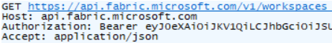
Fabric User API Design and Architecture
Fabric User API used to create and manage workspaces and workspace items
Fabric User API designed to be accessible to any developer on any development platform
Built using principles of REST and open security standards (OAuth2 and Open ID Connect)
Public cloud endpoint accessible through base URL of https://api.fabric.microsoft.com/v1
Fabric User API can be called as a [user] or as a [service principal]*
Caller must first acquire access token for Fabric User API from Azure AD
Caller must transmit access token in all API calls using Authorization header
Your Application
Fabric REST APIs
access token
JSON Result
HTTP Response: 200 OK

Slide 4










Workspaces with Sample Fabric Solution Scenarios
Fabric Power BI Solution
Fabric Lakehouse Solution with Notebook
Fabric Lakehouse Solution with Shortcut and Notebooks
Fabric Lakehouse Solution with Data Pipeline and Notebooks
Semantic Model
Report
Lakehouse
Notebook
Semantic Model
Report
Lakehouse
Shortcut
Notebook
Notebook
Semantic Model
Report
Report
Report
Lakehouse
Notebook
Notebook
Data Pipeline
Semantic Model
Report
Report
Report

Slide 5
Workspace Item Types
Fabric solutions designed and implemented in terms of workspace items
Developers can discover, create and manage workspace items inside scope of a workspace
Most (but not all) types of workspace items can be created and updated using item definitions
Blue workspace item types below are the ones we'll examine in this workshop
Creatable Workspace Item Types by Workload
Data Engineering
Power BI
Data Factory
Data Warehouse
Real-time Intelligence
Data Science
Lakehouse
SemanticModel
DataPipeline
Warehouse
Eventhouse
MLExperiment
Notebook
Report
Dataflow
MirroredWarehouse
Eventstream
MLModel
SparkJobDefinition
KQLDatabase
Environment
KQLQueryset
KQLDashbord

Slide 6
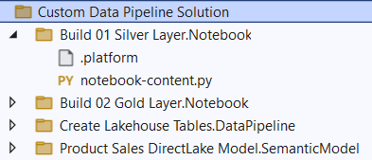
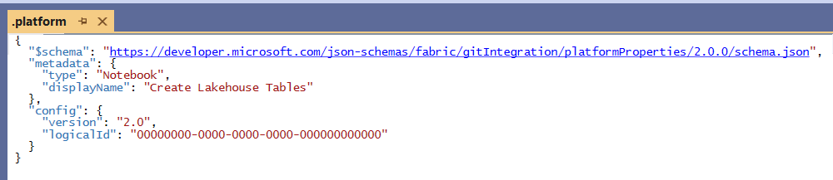
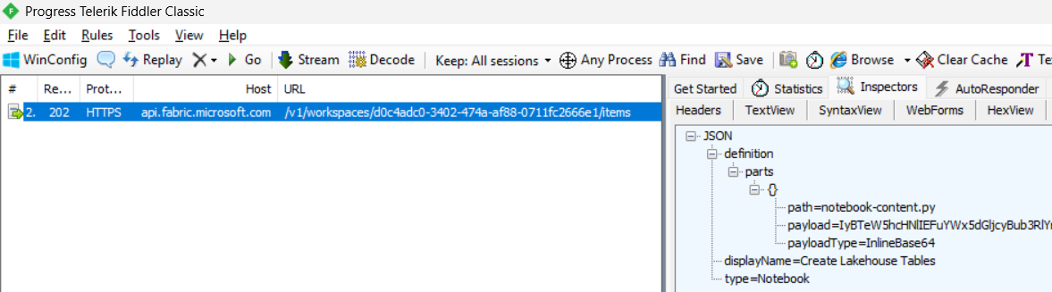
Item Definitions
Fabric DevOps strategy built on the concept of Item Definitions
Item definition is a set of files representing definition for a workspace item
Each type of workspace item has unique requirements for files in its item definition
Files in item definition known as item definition parts
Every item definition includes a platform file named .platform
Developer must format item definition parts with base64 encoding to transmit across network

Slide 7
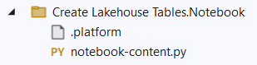
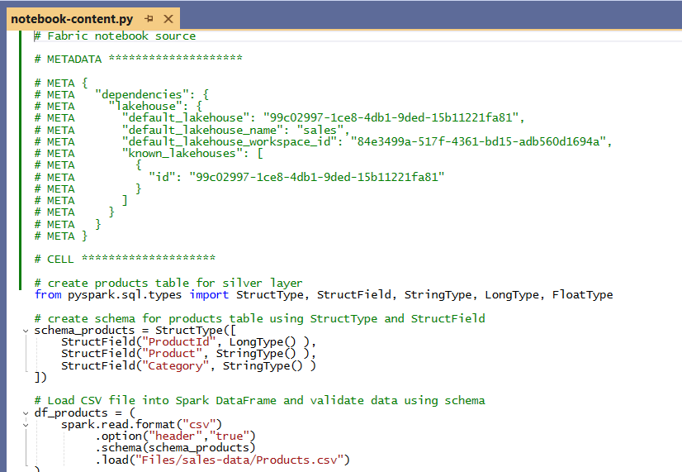
Notebook Item Definition Files
Item definition for notebook contained in single file named notebook-content.py
Default format for item definition based on is *.py files
Developers have option to work with JSON-based *.ipynb format
Top of file contains metadata section to link notebook to default lakehouse

Slide 8
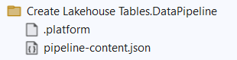
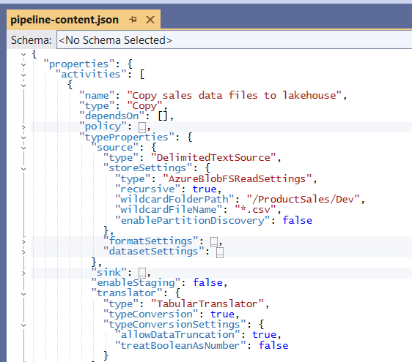
Data Pipeline Definition Files
Item definition for data pipeline contained in single file named pipeline-content.json
pipeline-content.json file contains reference for workspace Id and lakehouse Id
pipeline-content.json file contains notebook Ids and possibly other data pipeline Id
pipeline-content.json file contain partial data source paths

Slide 9
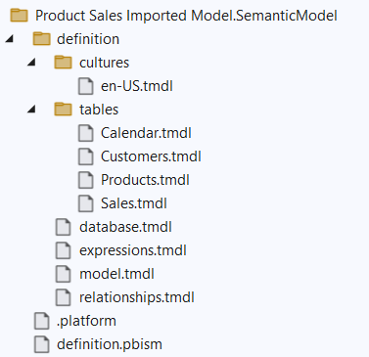
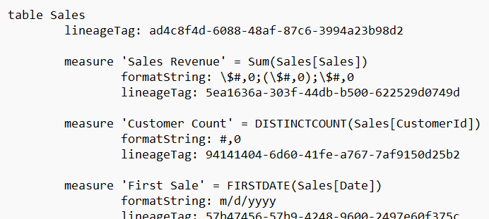
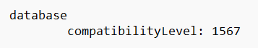
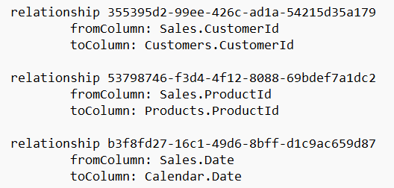
Semantic Model Item Definition Files
Item definition for semantic model supported in two different formats
Original format is TMSL which defines semantic model in single file named model.bim
New, preferred format is TMDL which uses YAML-like syntax using indentation
TMDL definition files are text-based and optimized for human readability and edit-ability

Slide 10
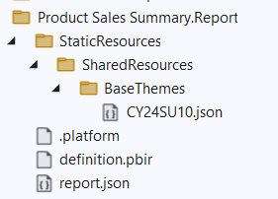
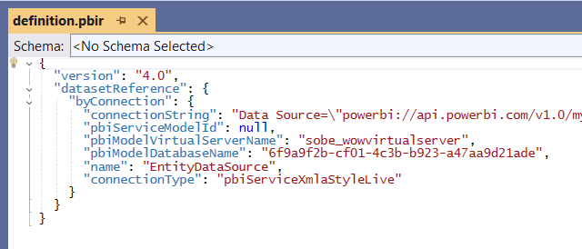
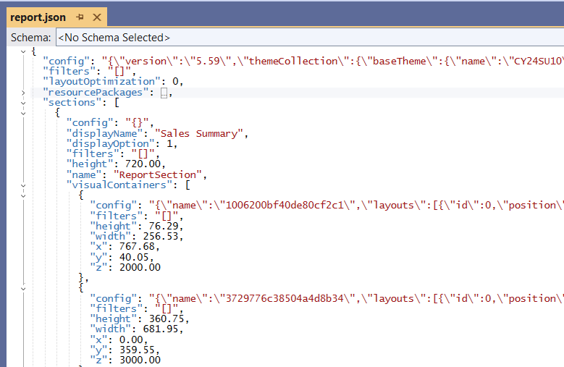
Report Item Definition Files
Item definition for reports supported in two different formats
Item definition files include definition.pbir which used to bind report to semantic model Id
Default format (PBIR-Legacy) based on report layout defined in single file named report.json
New format (PBIR) in public preview splits report definition into multiple files.
. and definition

Slide 11
Programming with Fabric Item Definitions
Fabric items can be created and updated using item definitions
You can pass item definition when calling Create Item API
You can modify existing workspace item by calling Update Item Definition passing item definition
You can retrieve item definition for existing workspace item by calling Get Item Definition
Your Application
Fabric REST APIs
Item
Definition
POST - Create Item
Item
Definition
POST - Update Item Definition
Item
Definition
POST - Get Item Definition

Slide 12
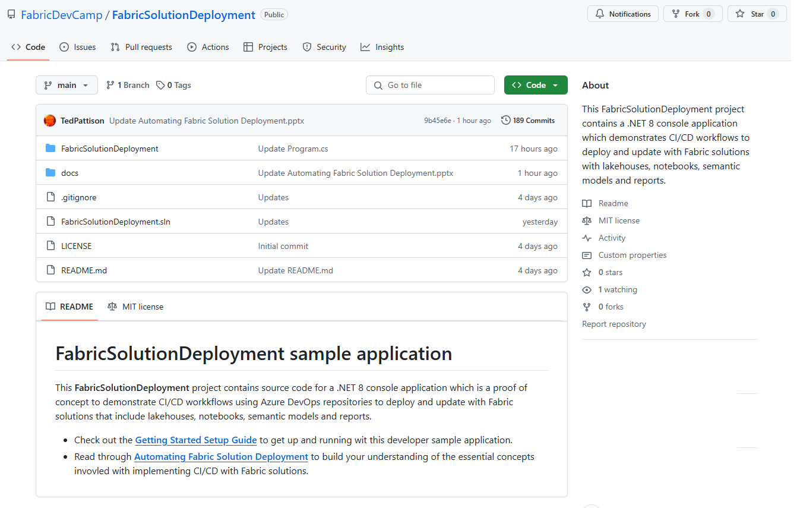
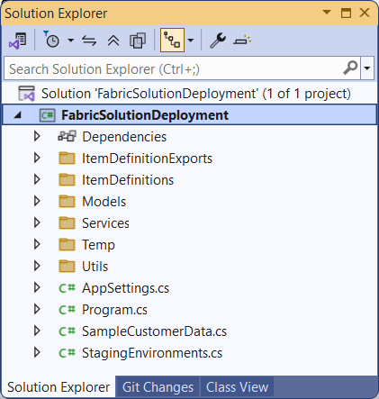
The FabricSolutionDeployment Developer Sample
Sample application demonstrating how to implement solution deployment workflows
Created as a .NET 8 console application using the Fabric REST API .NET SDK
Provides easy learning path for developers to download project and get up and running
https://github.com/FabricDevCamp/FabricSolutionDeployment

Slide 13
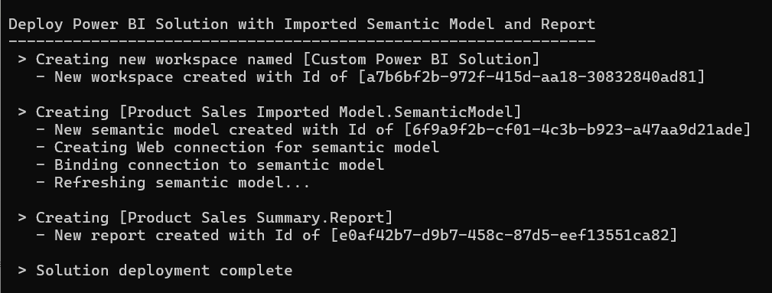
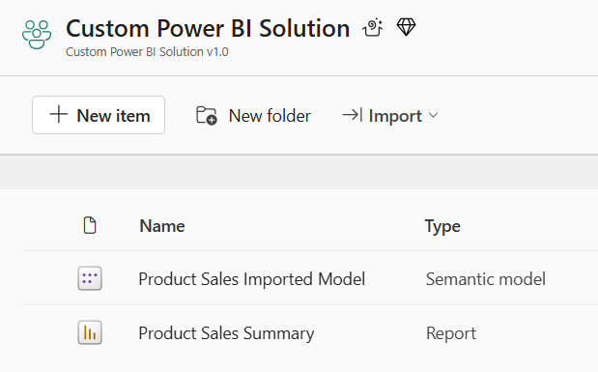
Deploy the Power BI Solution
Deployment steps with the Fabric REST API
Create workspace (assign capacity, add role assignments)
Create imported semantic model using Create Item API
Create connection for semantic model using Create Connection API
Bind semantic model to connection using Datasets - Bind To Gateway In Group API
Refresh imported semantic model using Datasets - Refresh Dataset In Group API
Create report which is bound to semantic model using Create Item API

Slide 14
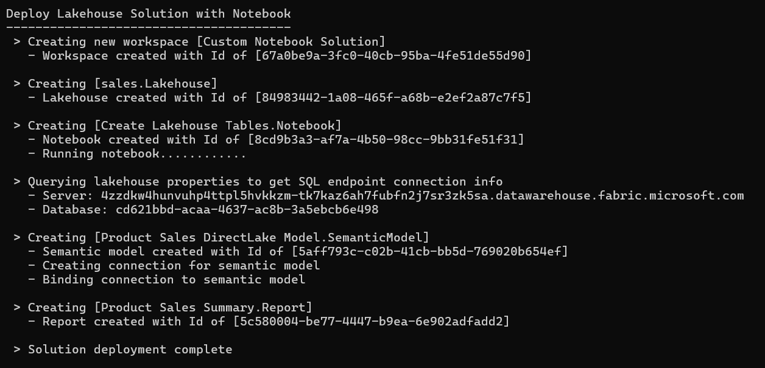
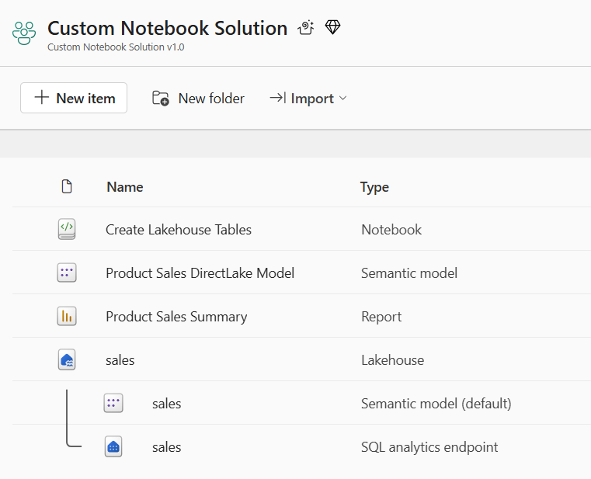
Deploy the Notebook Solution
Deployment steps with the Fabric REST API
Create workspace
Create lakehouse using Create Item API (lakehouse does not currently support item definition)
Create notebook which is bound to lakehouse using Create Item API
Run notebook using Job Scheduler - Run On Demand Item Job API
Create DirectLake semantic model on top of lakehouse tables Create Item API
Create connection to lakehouse SQL endpoint and bind it to DirectLake semantic model
Create report which is bound to semantic model using Create Item API

Slide 15
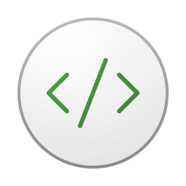

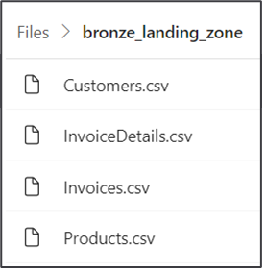
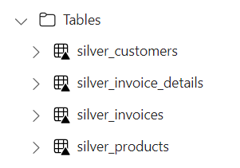
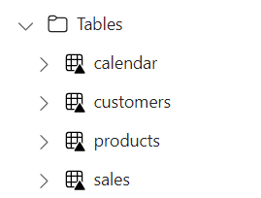


Using Spark Jobs to Create Lakehouse Tables
Fabric provides Spark runtime
Notebooks contain python code commonly used to ingest data files and build tables
Common practice to follow medallion architectures (bronze>silver>gold)
Fabric REST APIs provide Job Scheduler to run notebook and monitor its execution
Customer Tenant Workspace
Environment
Lakehouse
bronze layer
silver layer
gold layer
notebook
Spark job
Spark job
Spark job

Slide 16

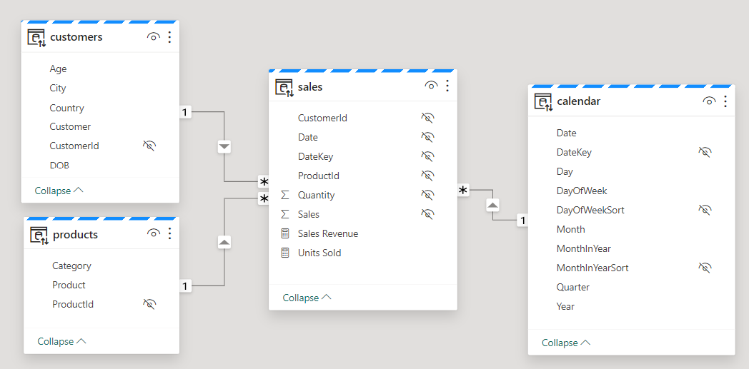
Creating DirectLake Semantic Models on Lakehouse Tables
Creating semantic model on lakehouse tables uses DirectLake mode
Semantic model created by passing model.bim to Create Item API
Semantic model allow you to define relationships, measures, hierarchies, etc.
CAVEAT: DirectLake semantic models do not support many import-mode features
Customer Tenant Workspace
Lakehouse
Semantic Model (aka Dataset)
SQL Endpoint

Slide 17
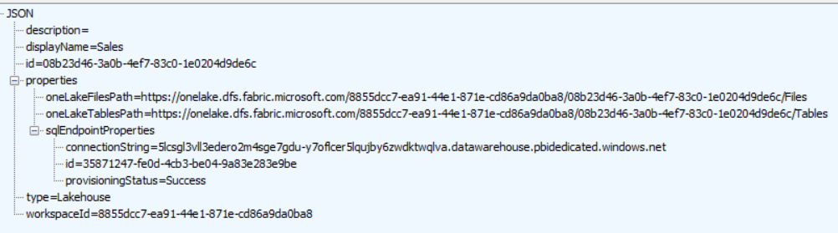
Lakehouse Properties
Retrieve lakehouse properties by executing GET request through /lakehouses endpoint
GET request with target URL of /workspaces/{WORKSPACE_ID}/lakehouses/{LAKEHOUSE_ID}
JSON response provides sqlEndpointProperties data required to create semantic model
SQL Connection Info

Slide 18
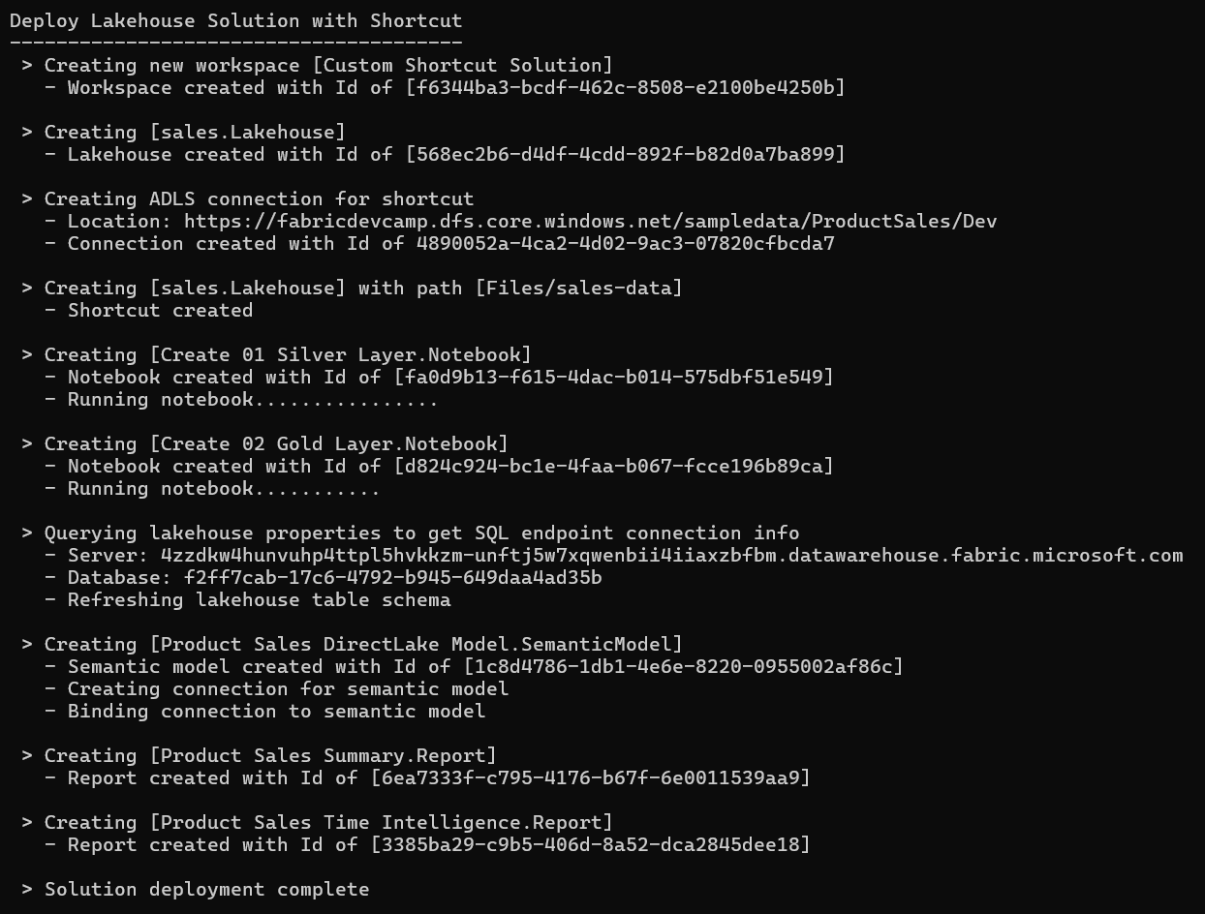
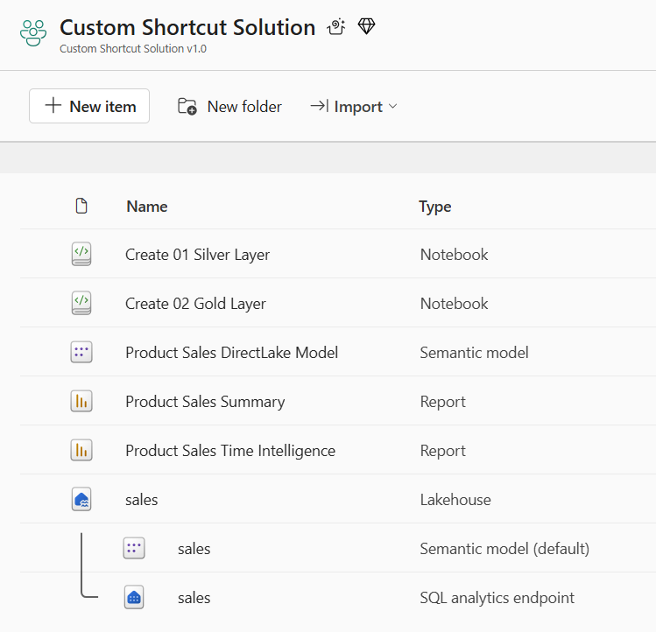
Deploy the Shortcut Solution
Deployment steps with the Fabric REST API
Create workspace
Create lakehouse using Create Item API
Create ADLS connection to Azure Data Lake Storage
Create shortcut in Files section lakehouse using ADLS to serve as bronze layer
Create and run two notebook to build out silver layer and gold layer
Create DirectLake semantic model with connection just like previous sample
Create two reports which are bound to DirectLake semantic model using Create Item API

Slide 19
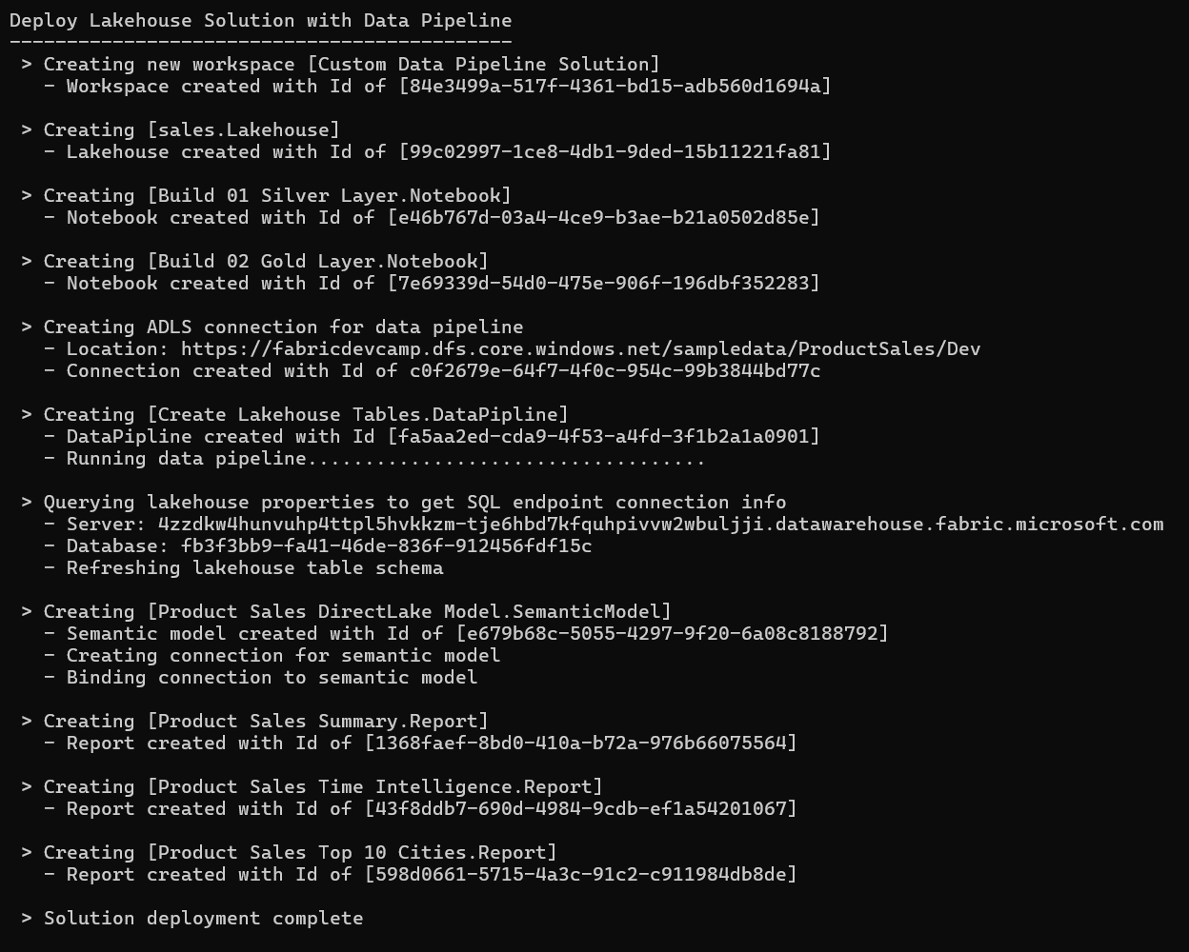
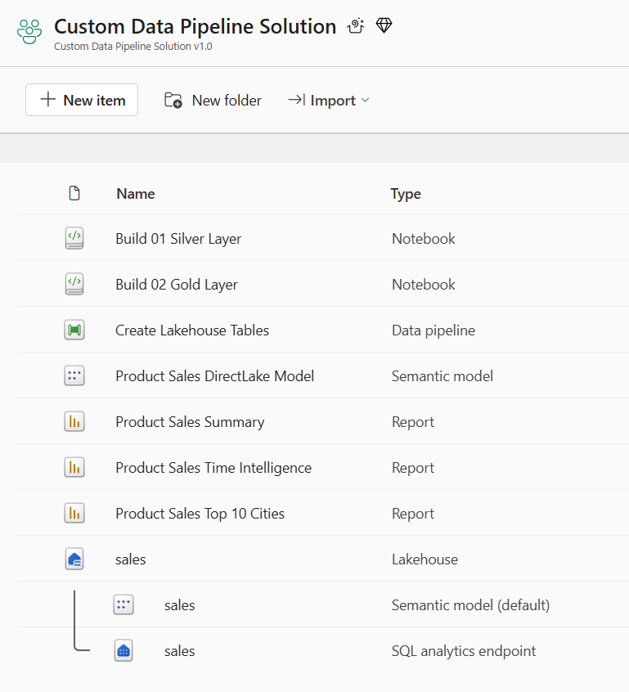
Deploy the Data Pipeline Solution
Deployment steps with the Fabric REST API
Create workspace
Create lakehouse using Create Item API
Create (but do not run) two notebooks to build out silver and gold layers
Create ADLS connection to Azure Data Lake Storage
Create data pipeline which uses ADLS connection
Run data pipeline to copy data files into lakehouse Files section and run the two notebooks
Create DirectLake semantic model with connection just like previous sample
Create two reports which are bound to DirectLake semantic model using Create Item API

Slide 20
Agenda
Creating Workspace Items using the Fabric REST APIs
Challenges in Fabric CI/CD and Solution Deployment
Configuring Datasource Paths using Deployment Parameters
Developing a Custom API-Driven Deployment Pipeline
Deploying and Updating Solutions from a Source Workspace
Exporting and Deploying Solutions using Solution Folders
Exporting and Deploying Solutions using GIT Branches

Slide 21
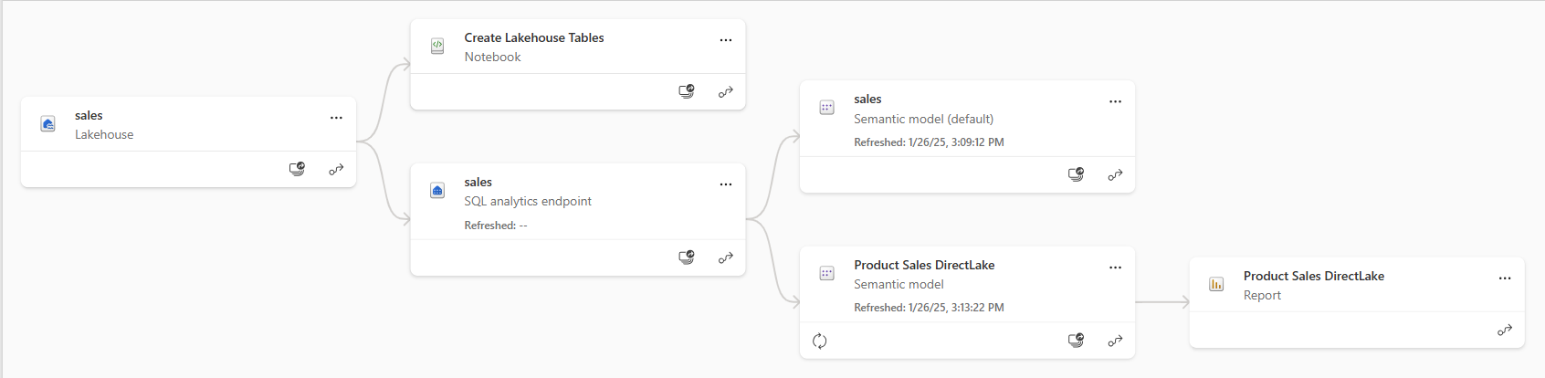
Understanding Workspace Item Dependencies
Many workspace items have dependencies on other workspace items
Lakehouse depends on running notebooks and/or data pipelines to create table schema
Notebook definition depends on workspace id and lakehouse id to reference its default lakehouse
DirectLake semantic model definition depends on connection string to SQL endpoint of lakehouse
Report definition depends on semantic model id
After deployment, solution should not have dependencies on other workspaces
All dependencies should be self-contained in new workspace
Fabric solution deployment requires custom logic to update dependencies accordingly

Slide 22
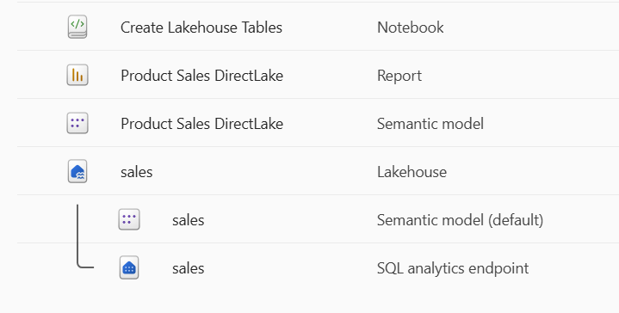
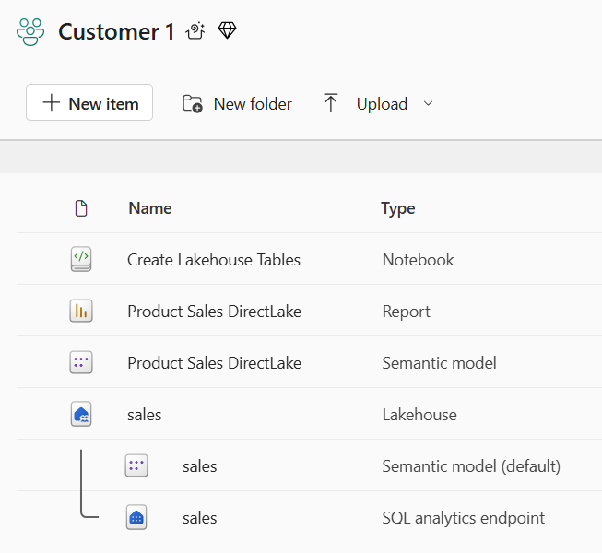
Creating Workspace Items with Dependencies
Deployment workflow must create workspace items with dependencies last
Notebook definition depends on lakehouse id for its default lakehouse
DirectLake semantic model definition depends on connection string to SQL endpoint of lakehouse
Report definition depends on semantic model id
Shallow copy of template workspace is not the result you want
Workspace for customer tenant should not have dependencies on source workspace
Source Workspace
Target Workspace

Slide 23
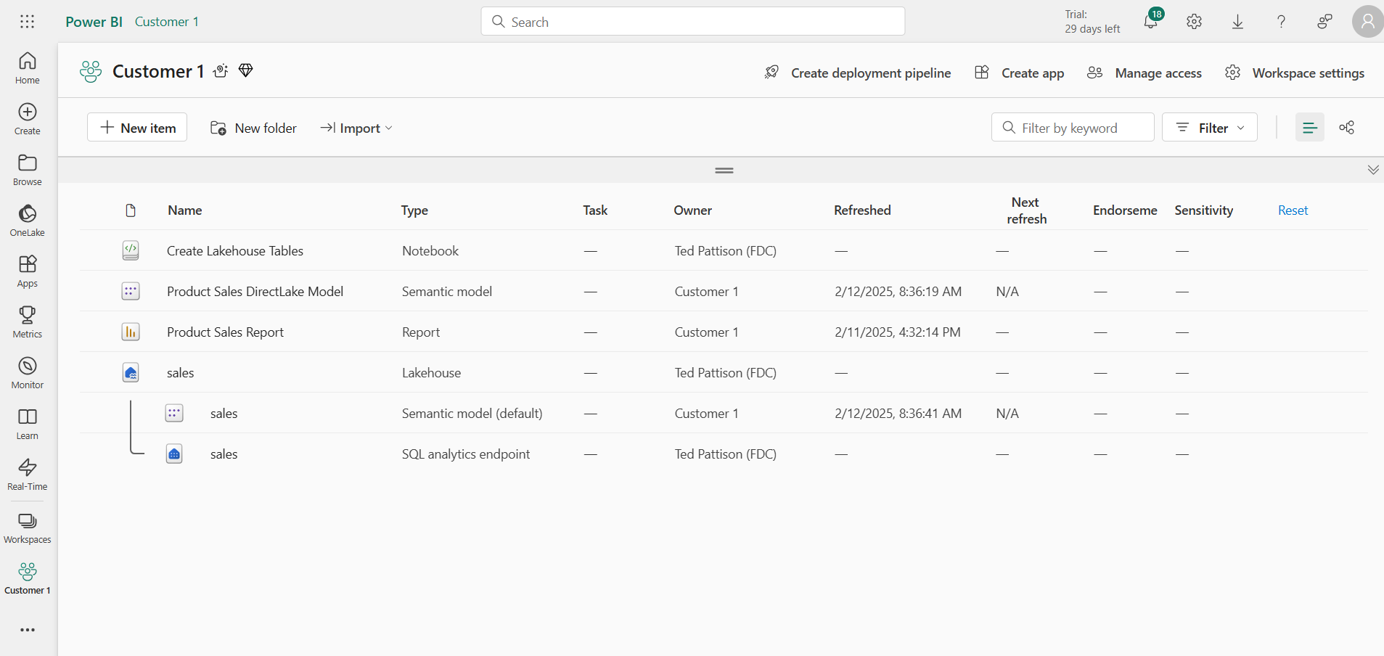
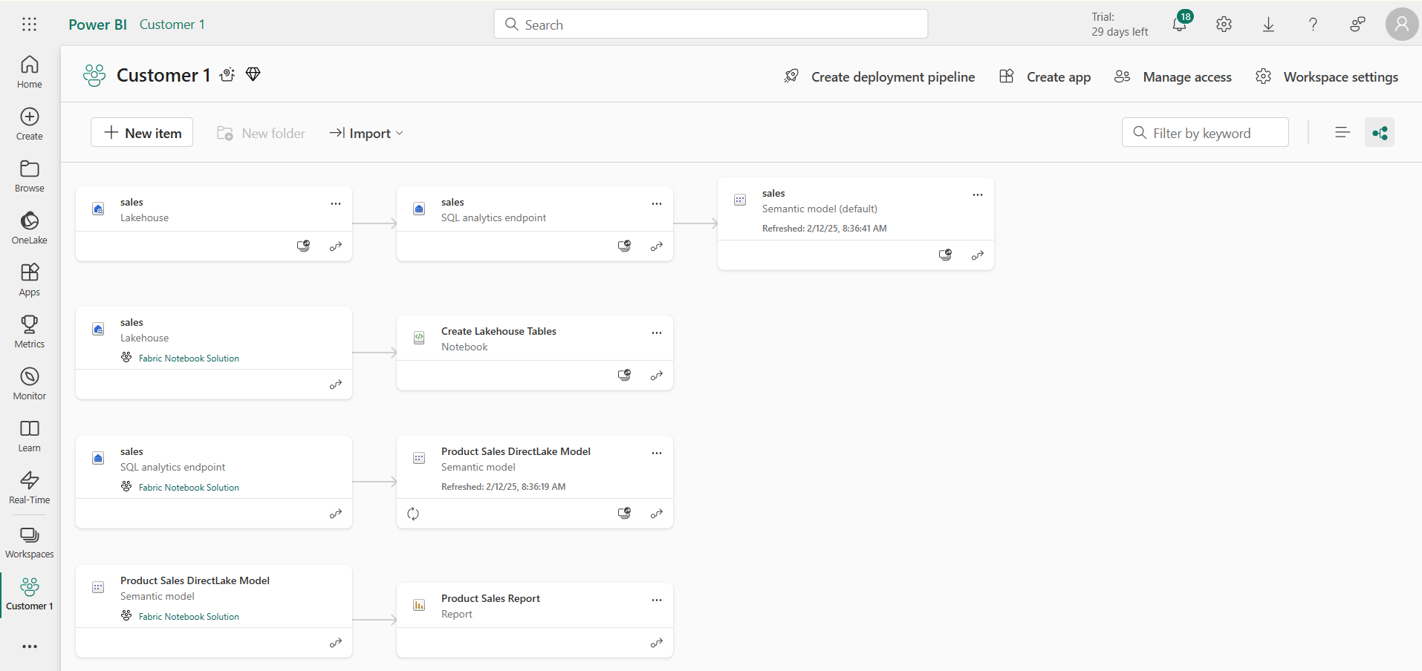
This deployment result IS NOT what you want
Checking for intra-workspace dependencies
Navigate to Lineage view to see item dependencies
Look for items that have dependencies on items in other workspaces

Slide 24
Challenge of Managing Connections at Workspace Scope
Unlike workspace items, connection items are scoped at level of Entra Id tenant
No API support for workspace-level management of connections
No support in Fabric GIT integration to track, backup, restore, recreate connections
Developer must find innovative approach for managing connections at scope of workspace
Platform Item Types
Capacity
Workspace
Connection
Gateway
Workspace Item Types by Workload
Power BI
Data Engineering
Data Warehouse
Data Factory
Real-time Intelligence
Data Science
SemanticModel
Lakehouse
Warehouse
DataPipeline
Eventhouse
MLExperiment
Report
Notebook
MirroredWarehouse
Dataflow
Eventstream
MLModel
SparkJobDefinition
KQLDatabase
Environment
KQLQueryset
KQLDashbord

Slide 25
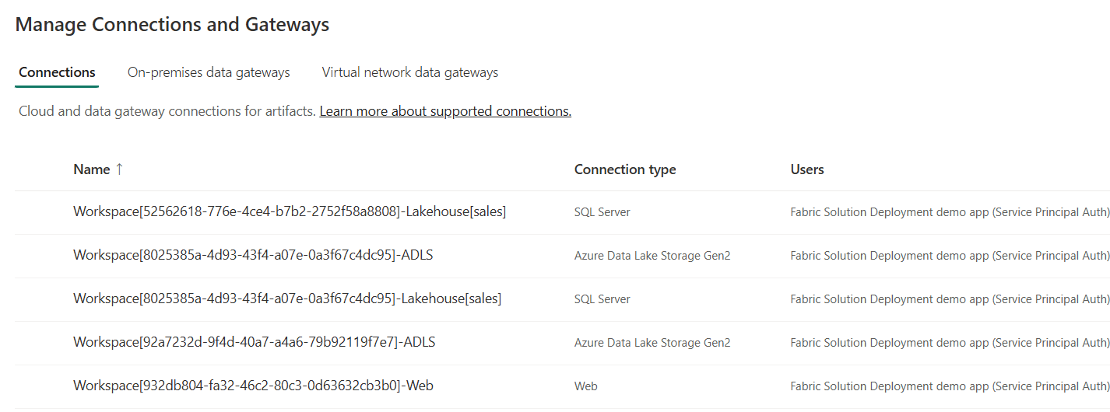
Using a Naing Convention for Managing Connections
Using connection naming convention allows for management at workspace scope
Connection name contains Workspace Id
Connection name also indicates connection type (e.g. Lakehouse(sales) vs ADLS vs Web)
Benefits to connection naming convention
It allows for cascading connection deletes when deleting workspace
Allows for discovery of connection when inspecting source workspace
Enables configuration when recreating lakehouse shortcuts and data pipelines
Workspace[WORKSPACE_ID]-Lakehouse[sales]
Workspace[WORKSPACE_ID]-ADLS
Workspace[WORKSPACE_ID]-Web

Slide 26
Agenda
Creating Workspace Items using the Fabric REST APIs
Challenges in Fabric CI/CD and Solution Deployment
Configuring Datasource Paths using Deployment Parameters
Developing a Custom API-Driven Deployment Pipeline
Deploying and Updating Solutions from a Source Workspace
Exporting and Deploying Solutions using Solution Folders
Exporting and Deploying Solutions using GIT Branches

Slide 27
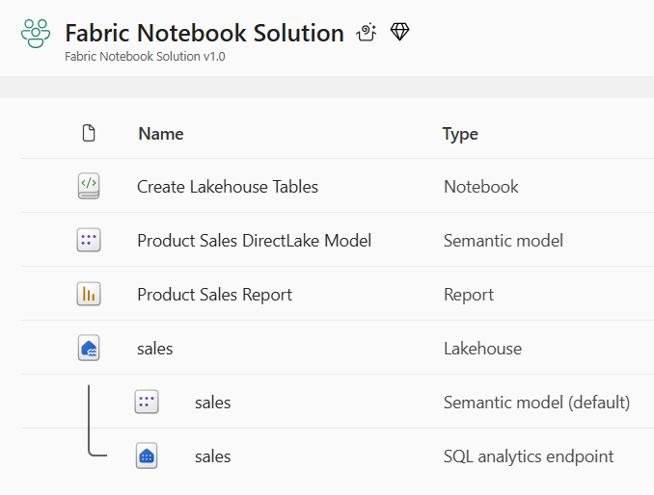
Parameterizing Customer Data and Datasource Paths
Solution design required to parameterize customer data
Deployment workflow must integrate creation parameters unique to each customer
This is especially true for datasource path
Customer 1 Datasources
Customer 1
Workspace
ADLS Gen2
Storage Container
Azure
SQL Database
Fabric Solution Template
Solution Deployment Logic
Customer 2 Datasources
Customer 2
Workspace
ADLS Gen2
Storage Container
Azure
SQL Database
Customer 3 Datasources
Customer 3
Workspace
ADLS Gen2
Storage Container
Azure
SQL Database

Slide 28
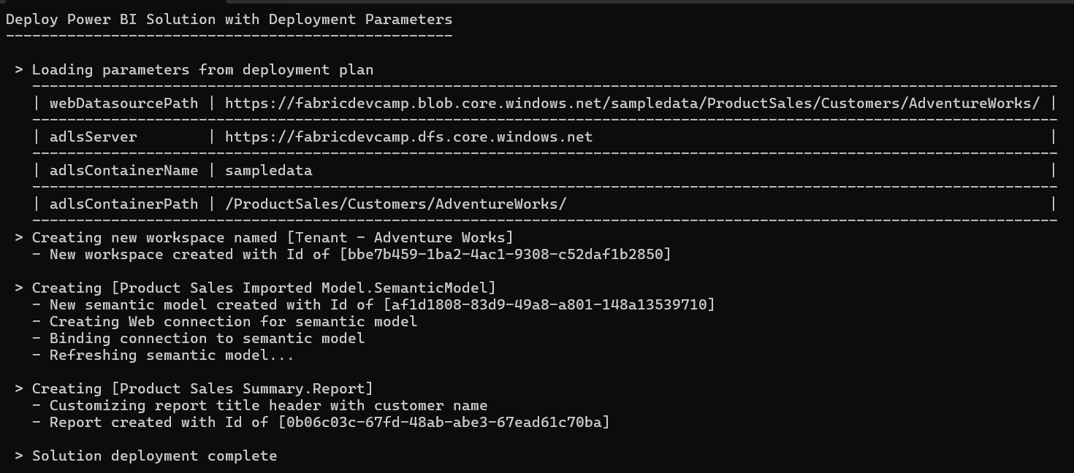
Deployment Parameters
FabricSolutionDeployment introduces concept of deployment parameters
Deployment logic in pipeline looks for presence of deployment parameters
When found, deployment parameters leads logic to modify target datasource paths

Slide 29
Where Do Datasource Paths Live in a Solution
Inside item definition files in semantic models
Example item definitions files with datasource paths include expressions.tmdl and model.bim
Inside Notebooks
Developers can add URLs directly in their python code
In connections
A connection is a credential bound to a datasource path
In shortcut
Shortcut created with datasource path
Shortcut must be bound to connection with same datasource path
In data pipeline
Data pipeline created to reference connection to external datasource
Connection created with target datasource path

Slide 30
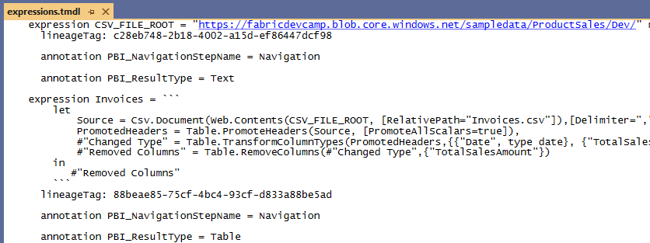
Data Path in an Imported Semantic Model

Slide 31
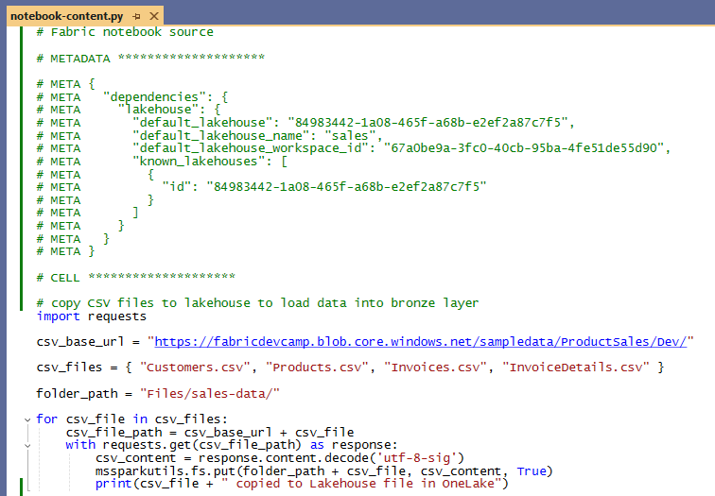
Datasource Path in a Notebook

Slide 32
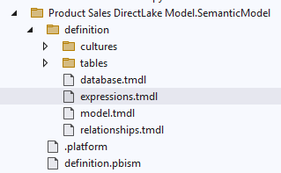
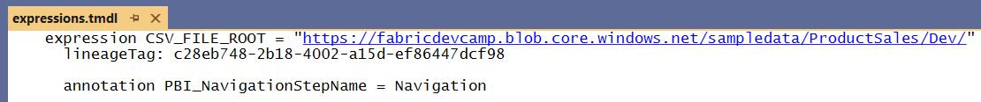
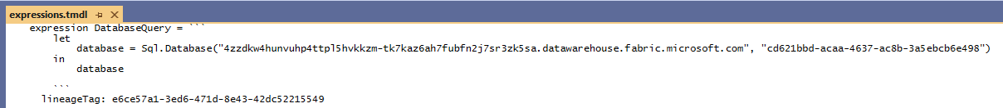
Data Source Path in a Semantic Model
The expressions.tmdl file is typical place to find datasource URL for semantic model
Example of imported model with datasource path for Web connection
Example of DirectLake model with datasource referencing lakehouse SQL endpoint

Slide 33
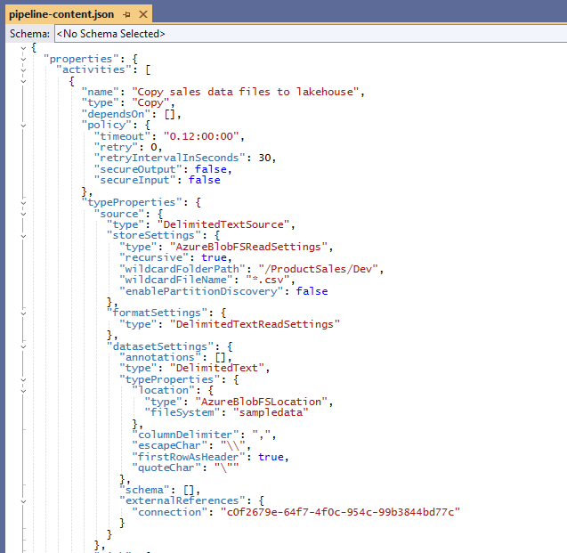
Datasource Paths and Connection Id in a Data Pipeline

Slide 34
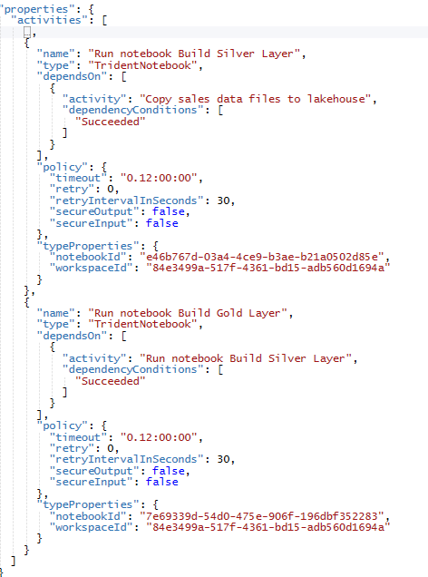
Workspace Id and Notebook Ids in Data Pipeline

Slide 35
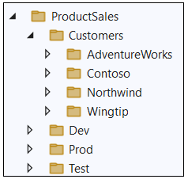
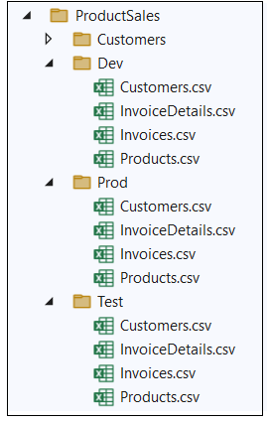
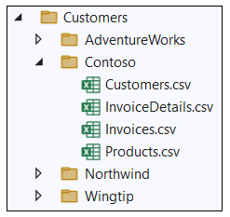
Sample Data Used in FabricSolutionDeployment
FabricSolutionDeployment uses Product Sales sample data
Sample data used to simulate data for different staging environments
Sample data used to simulate data for different customer tenants

Slide 36
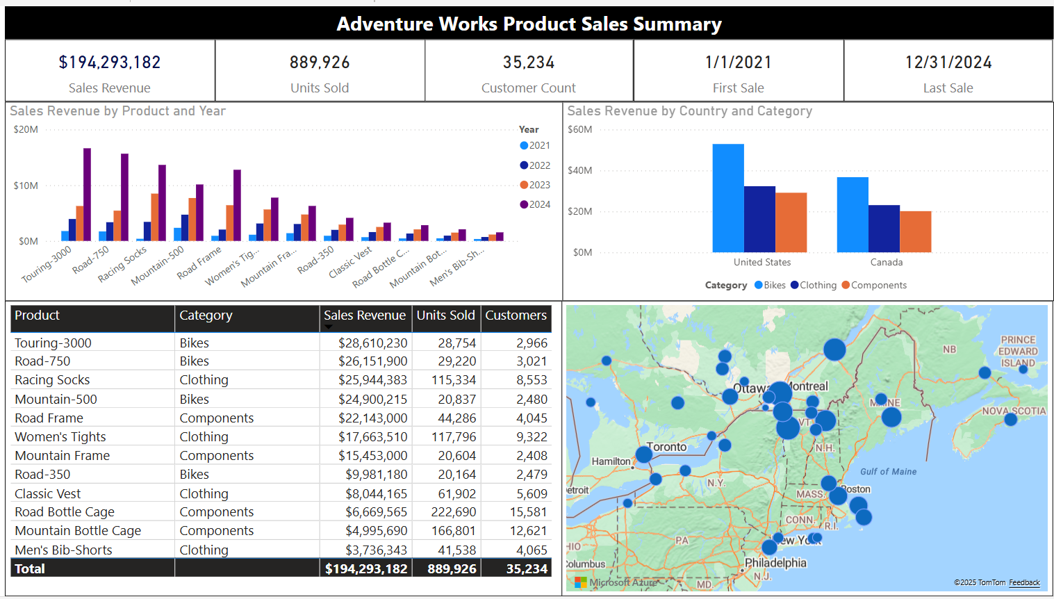


Adventure Works Sample Data

Slide 37



Contoso Sample Data

Slide 38



Fabrikam Sample Data

Slide 39



Northwind Sample Data

Slide 40



Wingtip Toys Sample Data

Slide 41



Seamark Farms Sample Data

Slide 42
Agenda
Creating Workspace Items using the Fabric REST APIs
Challenges in Fabric CI/CD and Solution Deployment
Configuring Datasource Paths using Deployment Parameters
Developing a Custom API-Driven Deployment Pipeline
Deploying and Updating Solutions from a Source Workspace
Exporting and Deploying Solutions using Solution Folders
Exporting and Deploying Solutions using GIT Branches

Slide 43
Developing a Custom API-driven Pipeline
Deploy workflow creates new target workspace and clones source workspace items
Deploy workflow always creates target workspace and builds it from scratch
Fabric REST APIs provide necessary CRUD APIs for managing workspace items
Update workflow processes set of updates on target workspace that already exists
Source workspace items that already exist in target workspace are updated
Source workspace items that do not already exist in target workspace are created
Source Workspace
Target Workspace
Deploy
Items
Source Workspace
Target Workspace
Update
Items

Slide 44
First Motivation for Custom API-driven Pipelines
Staged deployment used to push changes between environments like DEV>TEST >PROD
DEPLOY workflow creates downstream workspaces on demand
UPDATE workflow pushes out full update to all workspace items or partial update
DEPLOY and UPDATE workflows can cross environments such as Entra Id tenant boundaries
Building each stage requires configuring different datasource paths
DEPLOY workflow for must configure datasources differently for DEV, TEST and PROD
Entra Id tenant A
Entra Id tenant B
Entra Id tenant C
Dev Workspace
Test Workspace
Deploy
Items
Prod Workspace
Deploy
Items
Deploy
or
Update
Deploy
or
Update

Slide 45

Second Motivation for Custom API-driven Pipelines
Fabric provides development platform for building multi-tenant applications
Each customer tenant created using one or more Fabric workspaces
Developer uses Fabric REST APIs to create and configure workspaces and workspace items
Fabric Multi-tenant Environment
Entra Id Tenant Owned by ISV
Customer 1 Tenant Workspace
Customer 01
17 users
Lakehouse
Notebook
Semantic Model
Report
Custom
Multitenant Application
Customer 2 Tenant Workspace
Lakehouse
Notebook
Semantic Model
Report
Customer 02
85 users
Customer N Tenant Workspace
Lakehouse
Notebook
Semantic Model
Report
Customer N
450 users

Slide 46


Options for API-driven Solution Deployment
Option 1: Deploy from source workspace
Option 2: Export workspace to local solution folder and then deploy from local solution folder
Option 3: Export workspace to ADO repo branch and then deploy from that repo branch
Source Workspace
Solution Deployment Logic
Target
Workspace
Source Workspace
Packaged Solution Folder
Solution
Export
Logic
Solution Deployment Logic
Target
Workspace
Source Workspace
Solution
Export
Logic
Solution Deployment Logic
Target
Workspace

Slide 47

Deploy Solution from Source Workspace
Solution deployed from source workspace designed as solution template
Developer calls Get Item Definition on source workspace items
Developer modifies item definitions from source to redirect dependencies
Developer calls Create Item to create new item in solution workspace
Deploy Solution Logic

Slide 48
Deployment by Cloning Items from Source Workspace
Fabric items can be cloned using item definitions
Retrieve item definition from source workspace by calling Get Item Definition
Manipulate content of item definition part files such as substitute source Ids for target Ids
Pass manipulated item definition to Create Item API to create new item
Pass manipulated item definition to Update Item Definition API to update existing item
Source
Workspace
Your Application
Target
Workspace
Item
Definition
Item
Definition
Source
Definition
Create Item
Get Item Definition
update
Item
definition
Item
Definition
Updated
Definition
Update Item Definition

Slide 49


Performing Id Substitution with notebook-content.py
Notebook dependencies must be updated to point to newly created lakehouse
Source workspace Id must be replaced with target workspace id
Source lakehouse Id must be replaced with target workspace id
Substitution schema works even when there are multiple lakehouses
Your Application
Source
Definition
update
Item
definition
Search and Replace Operation
Output
Updated
Definition

Slide 50

Track Workspace Item Dependencies
Example of DeployFromSourceWorkspace function
Function creates large set of Dictionary<string, string> to track dependency substitutions
Function calls RecreateWorkspaceConnections

Slide 51


Recreating Source Workspace Connections
RecreateWorkspaceConnections calls GetWorkspaceConnections on source workspace
Conditional logic to create Web and AzureDataLakeStorage connections

Slide 52

Recreating Web Connections

Slide 53

Recreating ADLS Connections

Slide 54
Exporting for Fabric Solution Deployment
Export workspace to local solution folder and then deploy from local solution folder
Export process calls Get Item Definition on each workspace item and saves item definition files
Export process generates deploy.config.json file with extra metadata required for deployment
Source Workspace
Packaged Solution Folder
Solution
Export
Logic
Solution Deployment Logic
Target
Workspace

Slide 55




deploy.config.json

Slide 56

Staged Deployment for Multitenant Scenario
High-level architecture for CI/CD with multiple target workspaces
Changes are propagated to DEV workspace using feature workspaces and pull requests
Test Workspace
Customer 1 Workspace
Custom
Import
Logic
Deploy
or
Update
Dev Workspace
Customer 2 Workspace
Custom
Export
Logic
Deploy
or
Update
Deploy
or
Update
Customer N Workspace

Slide 57
Staged Deployment for Multitenant Scenario
High-level architecture for CI/CD with multiple target workspaces
Changes are propagated to DEV workspace using feature workspaces and pull requests
Dev Workspace
Test Workspace
Customer 1 Workspace
feature01 Branch
GIT Integrated Serialization
Custom
Export
Logic
Custom
Import
Logic
Feature01 Workspace
Deploy
or
Update
main Branch
pull requests
Customer 2 Workspace
Deploy
or
Update
feature01 Branch
Feature01 Workspace
pull requests
Deploy
or
Update
Customer N Workspace

Slide 58
Summary
Creating Workspace Items using the Fabric REST APIs
Challenges in Fabric CI/CD and Solution Deployment
Configuring Datasource Paths using Deployment Parameters
Developing a Custom API-Driven Deployment Pipeline
Deploying and Updating Solutions from a Source Workspace
Exporting and Deploying Solutions using Solution Folders
Exporting and Deploying Solutions using GIT Branches

